Slide 1
Healthcare Expense Analysis
IST 687
Team 3
Shubh Mody
Kunjan Ashish Chauhan
Yixing (Leo) Zhu
Nicholas Lukowsky

Slide 2
Project Goals
The dataset includes real-life healthcare customer data.
Provide insights from business mindset.
Using different models and data analysis techniques, look to find common trends between the individual customer characteristics and healthcare cost.
Focus points:
Why are some customer's healthcare costs more expensive than others?
What are the factors that cause a customer's healthcare expenses to increase or decrease?
What can HMO do to reduce their expenditure on customers?

Slide 3
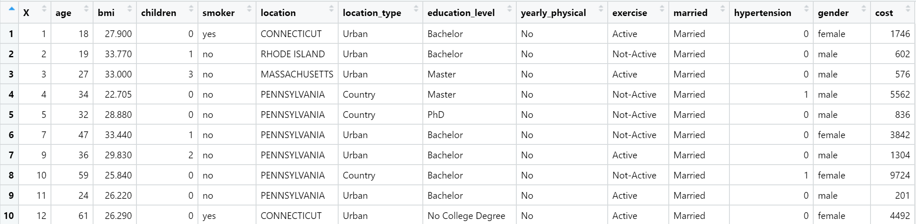
Dataset Characteristics
Health cost information from an HMO
7,582 rows (customers)
14 columns (variables)

Slide 4
Important Variables Relating to Cost
Age:
How one's health care cost is affected by his/her age?
BMI:
Whether BMI plays an important role in determining one's health care cost?
Smoker:
How one's lifestyle habits affect how much they spend on healthcare?
Exercise:
Whether the activity level of a customer influences their healthcare expenses?
Location:
Can healthcare expenditure relate to the state where someone lives?

Slide 5
Associating Important Attributes (Apriori)
Older Adults – Smoker – Inactive – No Yearly Physical (Confidence 96.5%)
Older Adults – Smoker – Inactive (Confidence 96.3%)
Older Adults – Smoker – Inactive – Married (Confidence 96.3%)
Older Adults – Smoker – Inactive – No Hypertension (Confidence 96.2%)
As we see Older adults who smoke and are inactive are highly likely to cost us more.

Slide 6
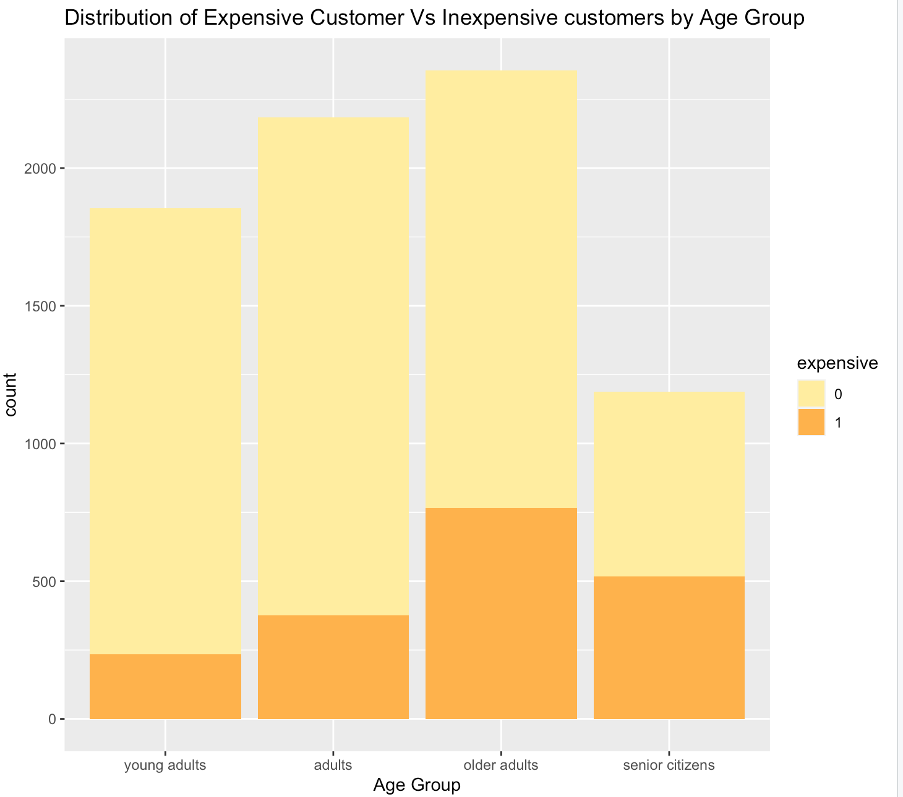
Healthcare Cost of Different Age Group
Threshold to consider a customer expensive set at $4775 (Q3 value).
The percentage of expensive customers increases with increase in the age group of the customers.
Even though there are fewer data points for customers in the senior citizens category, we still see that their healthcare cost is far more than young adults and adults.

Slide 7
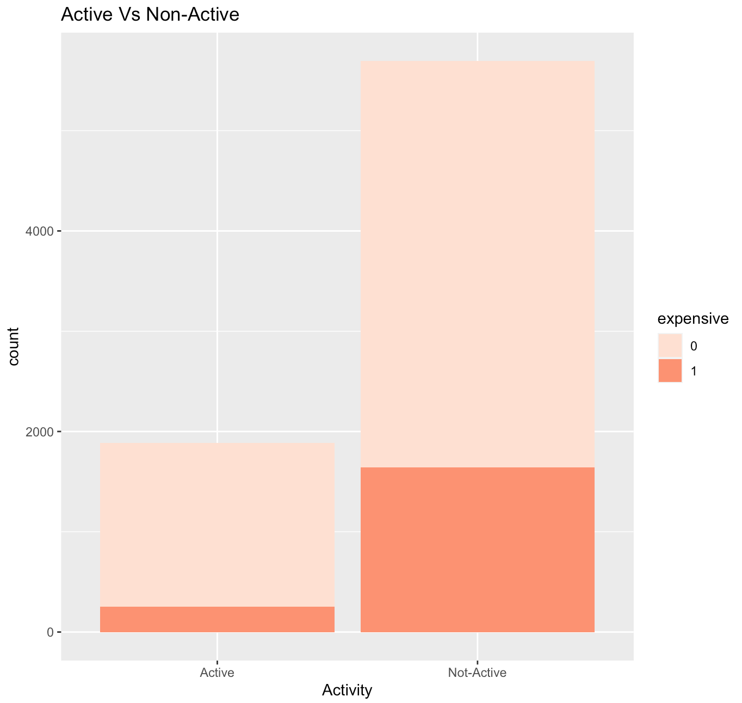
Healthcare Cost of Different Activity Levels
Customers who are less active are more likely to have higher healthcare cost expenses.
Fewer customers identify as active altogether, but they have a smaller percentage of health care costs that are classified as expensive.

Slide 8
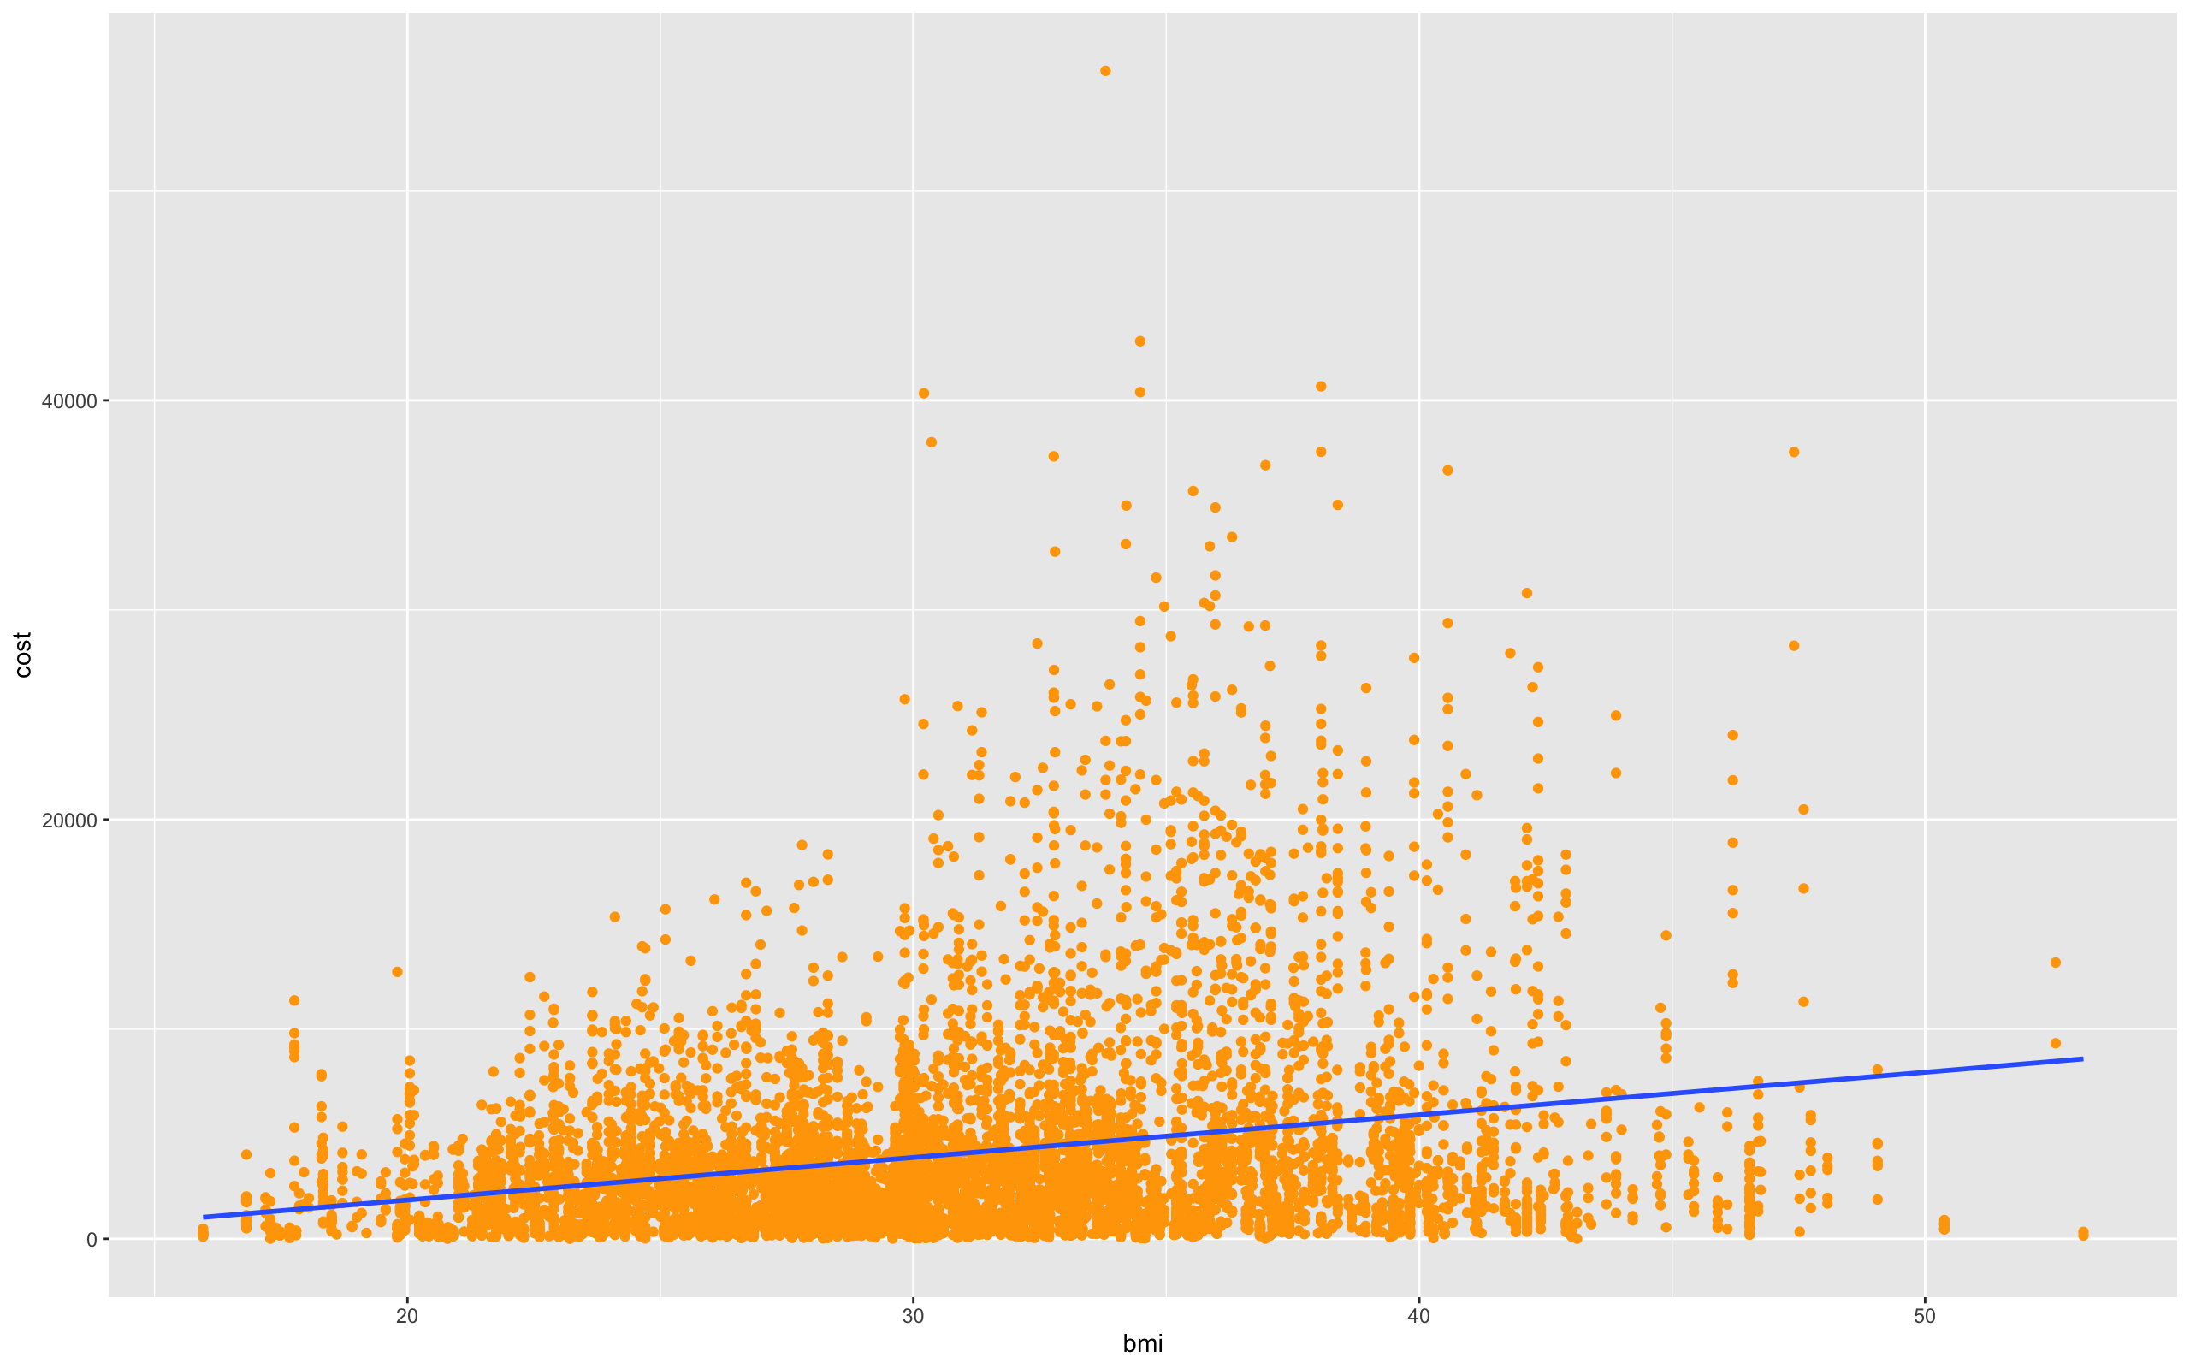
Healthcare Cost Relation with BMI
As the BMI increases, customers tend to have more healthcare issues.
High BMI usually means obesity and unhealthy lifestyle.

Slide 9
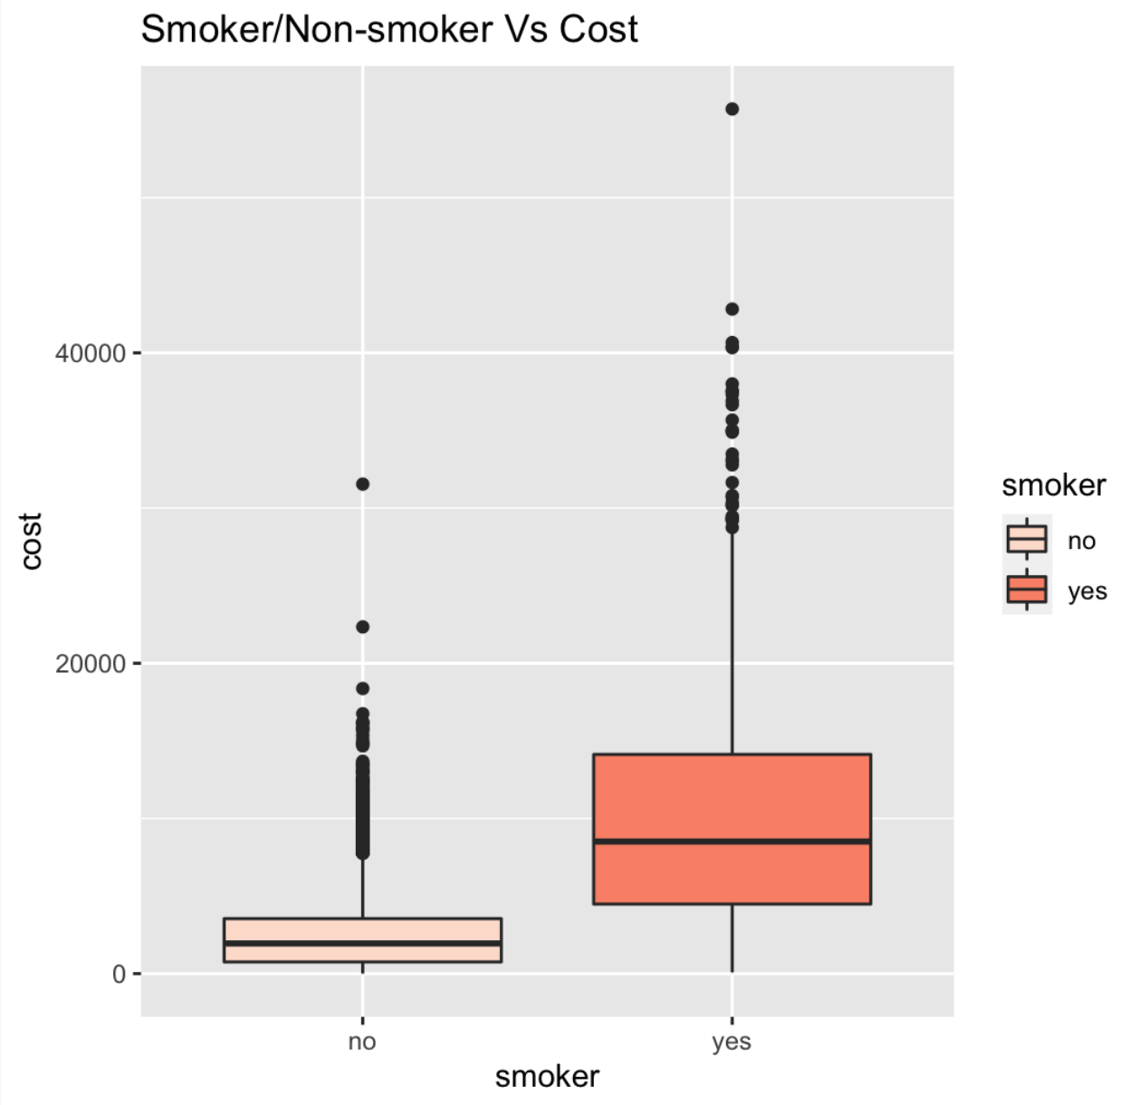
Healthcare Cost Relation with Smoking
If a customer is a smoker, it has a drastic impact on the cost of his/her healthcare.
The median cost for smokers is 4 times that of non-smokers, as well as the group containing larger outliers.

Slide 10
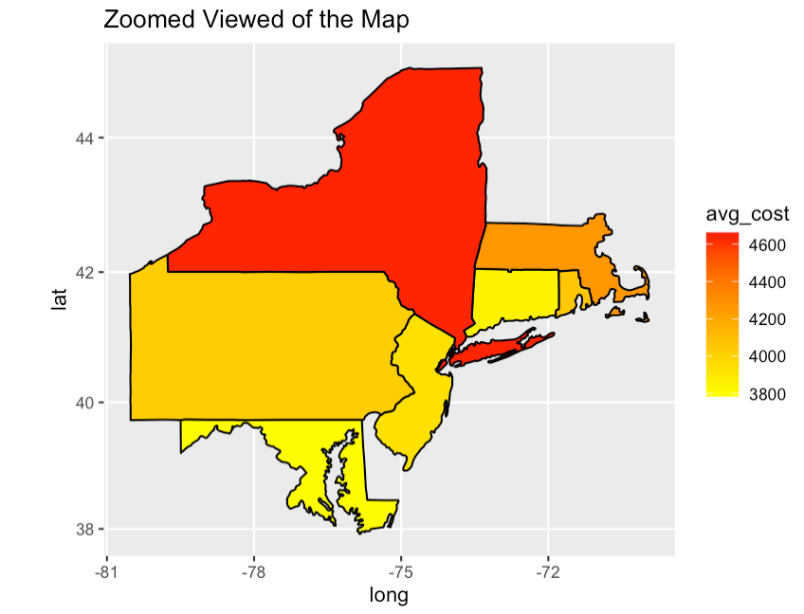
Northeastern States Map of Average Cost
For the states included in the dataset the average cost of healthcare is shown.
Massachusetts and especially New York have higher cost while Connecticut and Maryland have lower cost.

Slide 11
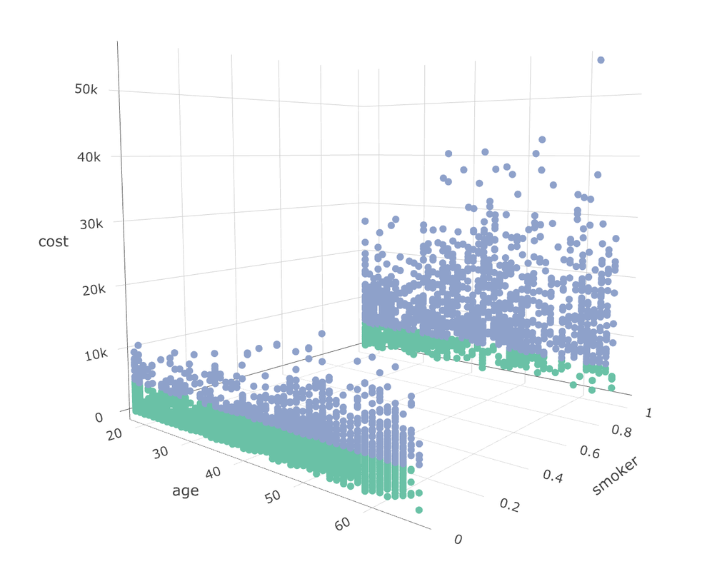
Healthcare Cost Relation with Age & Smoking
Using a three-dimensional plot of age and smoker is shown against the healthcare cost.
For non-smokers the cost is relatively low & constant as age increases, however for smokers the cost is generally larger and increases with age.

Slide 12
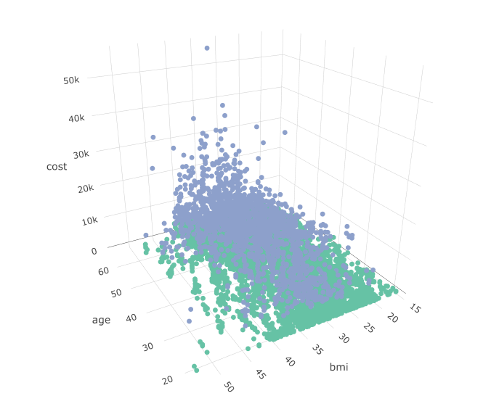
Healthcare Cost Relation with Age & BMI
Increasing BMI with increasing age has higher number of customers which are expensive.
BMI alone with cost was quite scattered, but this graph shows BMI of 30 for age 20-30 doesn’t affect cost by much. But the same BMI for age above 40 have higher cost.

Slide 13
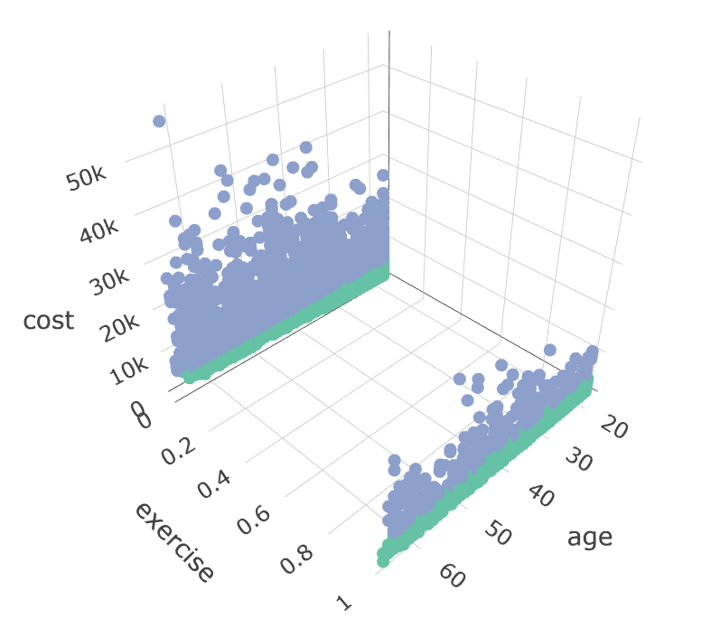
Healthcare Cost Relation with Age & Exercise
Using a three-dimensional plot age and the categorical variable of exercise is shown against the healthcare cost.
For active people the cost is relatively low & constant as age increases, however for non-active people the cost is generally larger.

Slide 14
Classifying Expensive Customers using Machine Learning
To predict whether the customer will be expensive or not using all of their personal information from the dataset.
Age, BMI, Smoker, Exercise and location (states) were significant predictors to identify expensive customers.
The accuracy of the SVM classification model is 87.66% with sensitivity of 96.48%
The accuracy of the Classification Tree is also 87.6% with a higher sensitivity of 97.89%.

Slide 15
Conclusion and Recommendation
Having associated the attributes for expensive customers, we can be selective in attracting our future customers.
As a second option, we can increase monthly premiums for customers who are potentially expensive.
Younger people tends to have lower healthcare costs while older people tend to have higher costs. Based on this we can group customer age brackets and determine a higher monthly premium based on the age bracket.

Slide 16
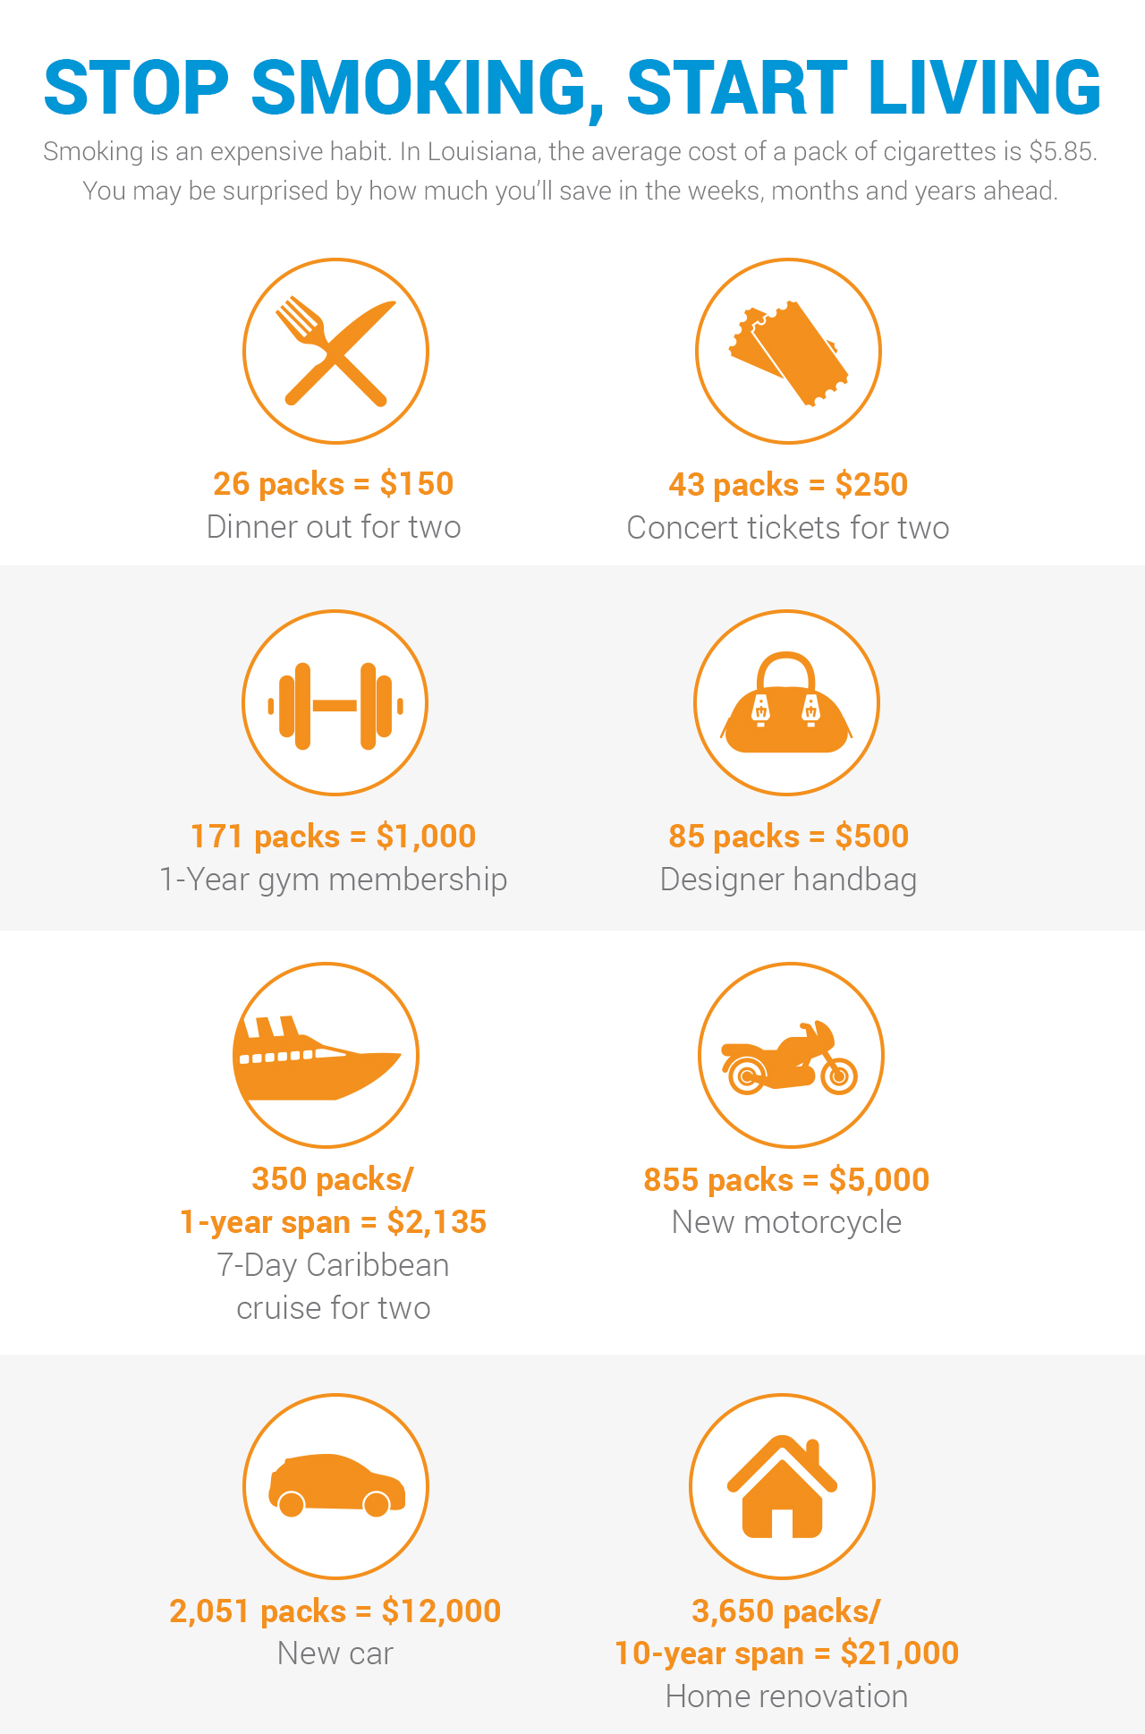
Conclusion and Recommendation
Three factors affect the persons health (BMI, Smoking, Exercise).
A balanced, calorie-controlled diet is the ticket to a healthy BMI – the safe way.
Woww! Look at what you all can buy if you "Quit" smoking
Exercise is one of the key ways in which you can actively reduce your BMI

Slide 17
The End

